Slide 1

Hotel Management Project
Chenchen Shao
Per1
04/13/2025

Slide 2
Features
GUI design, easy to use, clear
Highly customizable
Small size
Fits low resolution screens
Auto-generated save files
Cross platform (Any device with Java installed)

Slide 3
What Can User Do?
Register an account
01
Log in to the system
02
Log out
03
Book the room (Cancellable)
04
Add rooms to cart (Remove items, check out)
05
Check in and check out
06
Wait list system (Join wait list, quit wait list)
07

Slide 4
What Can Admin Do?
Built in set and get methods for problem fixing
Managing staffs, rooms, and customers
Independent java file to for operations and logs
Admin mod
Log in directly as admin in GUI
Quick check for room status and staff status

Slide 5
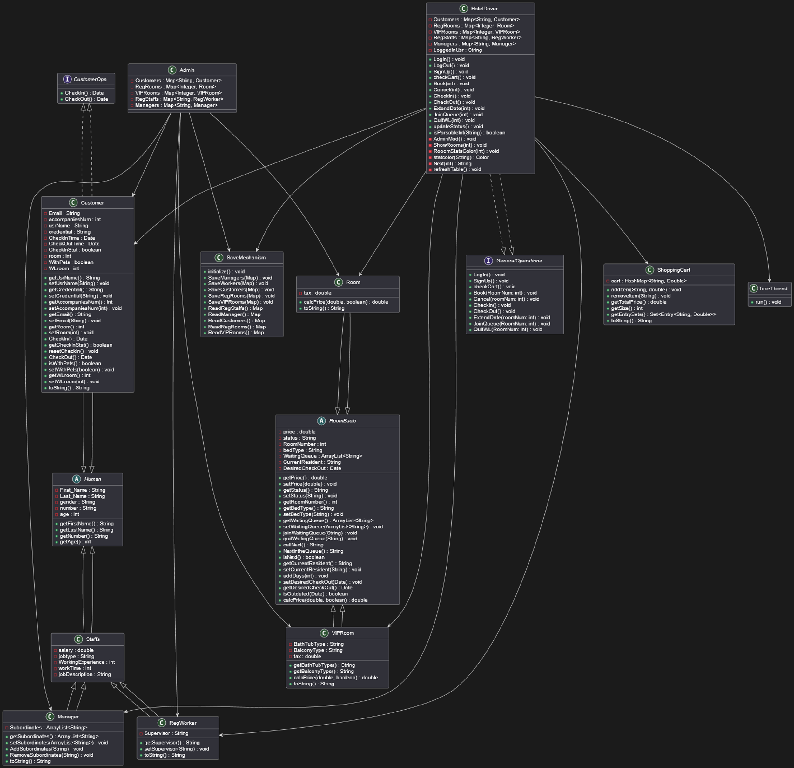
UML Diagram
Here is the link
UML
Or see the attachment in the folder

Slide 6

Objects

Slide 7
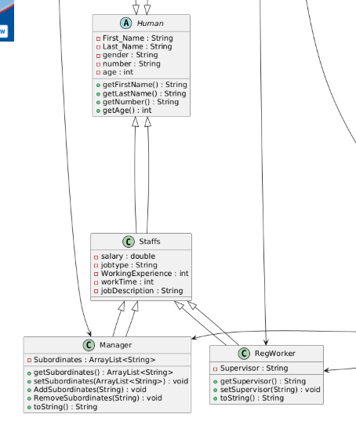
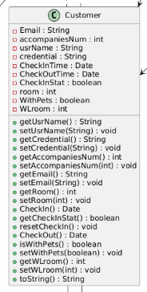
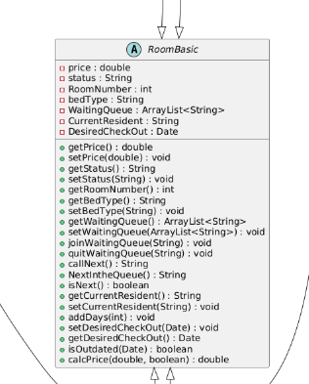
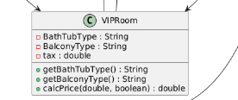
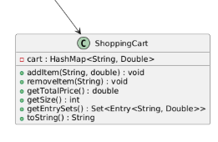
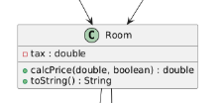
Representing Physical Objects

Slide 8
Customer and Human Object
Human Object:
Basic Properties
Name
Gender
Age
Number
Customer inherited from Human:
Additional Properties
Room booked
Account
Credential
Etc.
Customer object is treated as an account, contains everything needed for booking hotel.
Fundamental objects that user can directly make changes of. Include seter and getter method for each property
Separate Human Object can also use for staff object for staff management

Slide 9
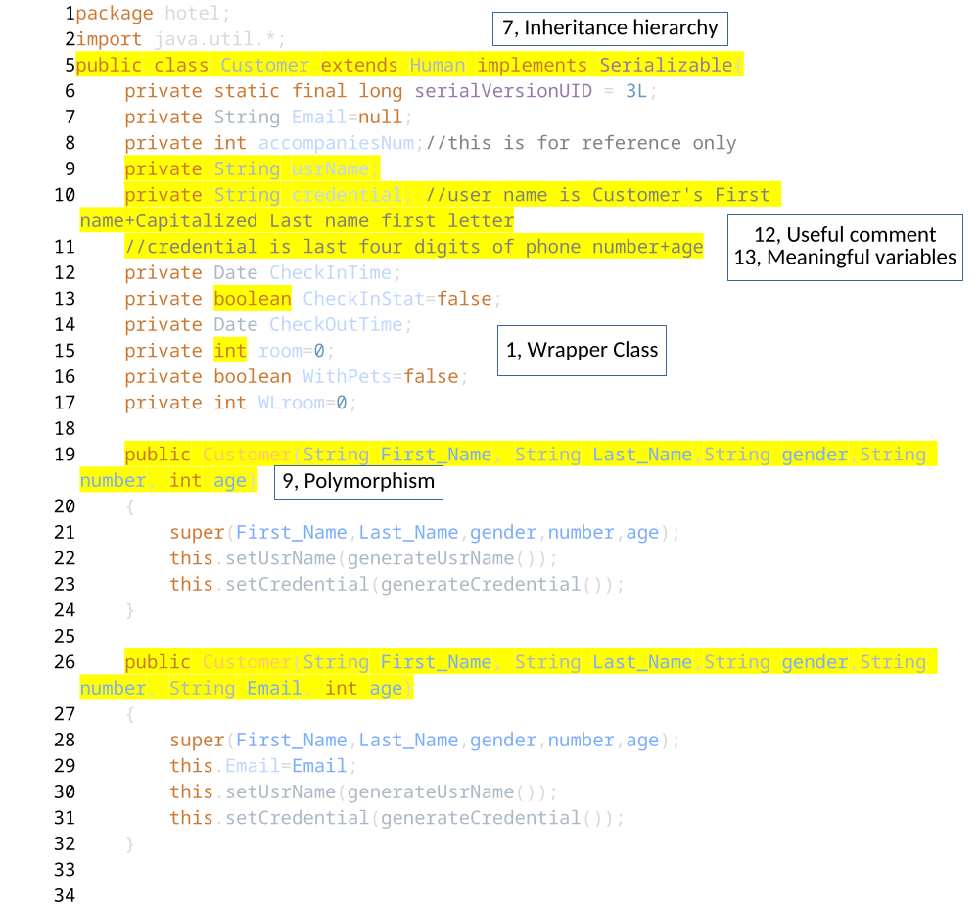
Customer
Polymorphism
Emaill not necessary, so add extra parameter to constructor
Internal method
Auto generate username and credential with customer's name, phone, and age info.
Check in and check out as core method customer needs to interact with room object

Slide 10
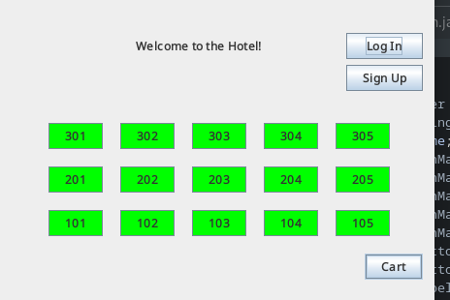
Rooms
The core object, directly associate with bill generation, waiting list system and booking system.
Use status(String) for indicator, indicating whether its, occupied, available or booked.
If somebody in the waitlist, it will show reserved as nobody else is booking or living in it (ArrayList)
Calculation of desired checkout date
This date can be extended using the add to day method, using java util date and calendar libs
Internal method that allows it to judge whether the customer should move out or not
Bill generation will consider pets

Slide 11
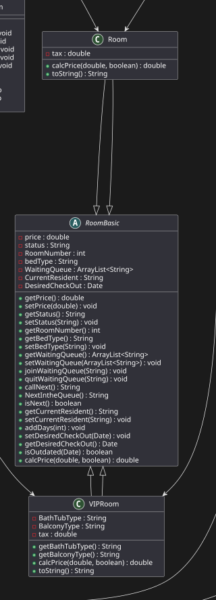
RoomBasic, Room, and VIPRoom
Room and VIPRoom inherited from RoomBasic
VIPRoom and Room are just variant from Room Basic with different selectable furniture type, and different tax
Most of changes can be made in Room object
Simple to modify things or adding another method
However, due to the type different, both objects will be treated separately

Slide 12

More...
Staffs (Abstract Human Object with more properties: salary, job Etc.)
Manager
+ Subordinates Property as ArrayList<String> to search and get object in RegStaffs HashMap
Regular Staff
+ Supervisor as string
Shopping cart, hashmap with more functions like calculating total price (include tax)
Everything implements Serializable!

Slide 13

Driver

Slide 14
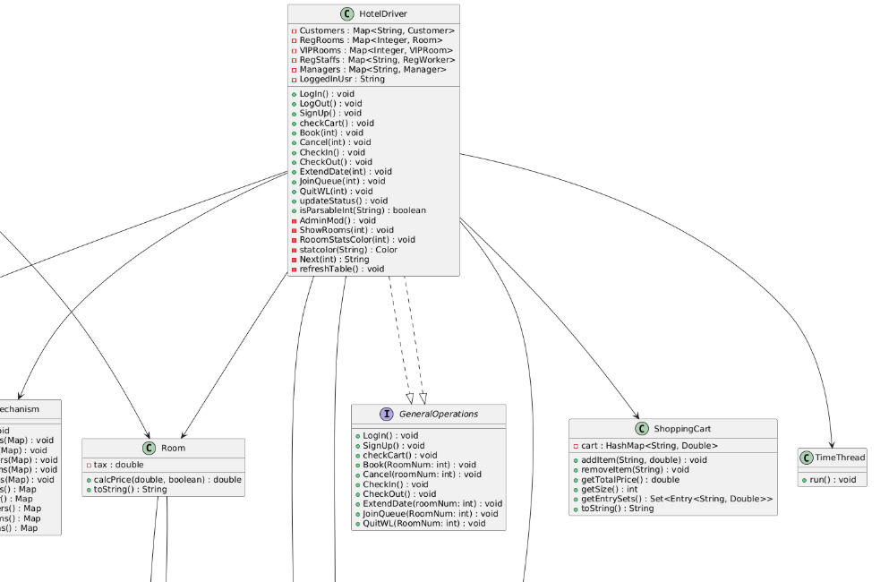
The Grand Octopus
Connects everything...
Where the GUI is created
Implemented GeneralOps as what user can do

Slide 15
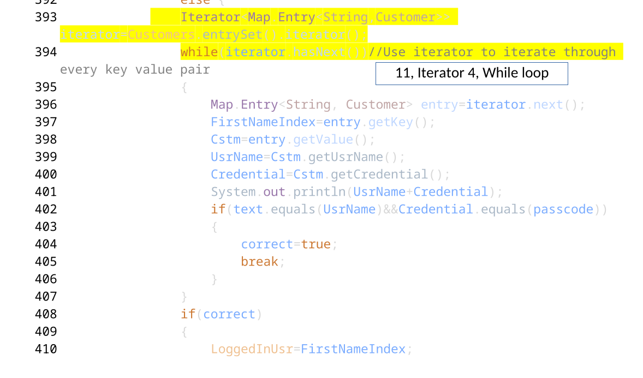
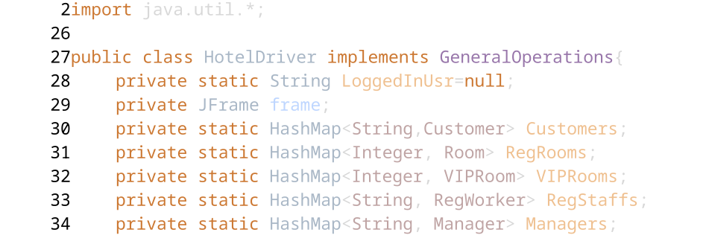
Inheritance and methods
Inherited from an interface describing methods that Customer may perform
Internal method that connect every operation to GUI
Easy to access, easy to modify

Slide 16
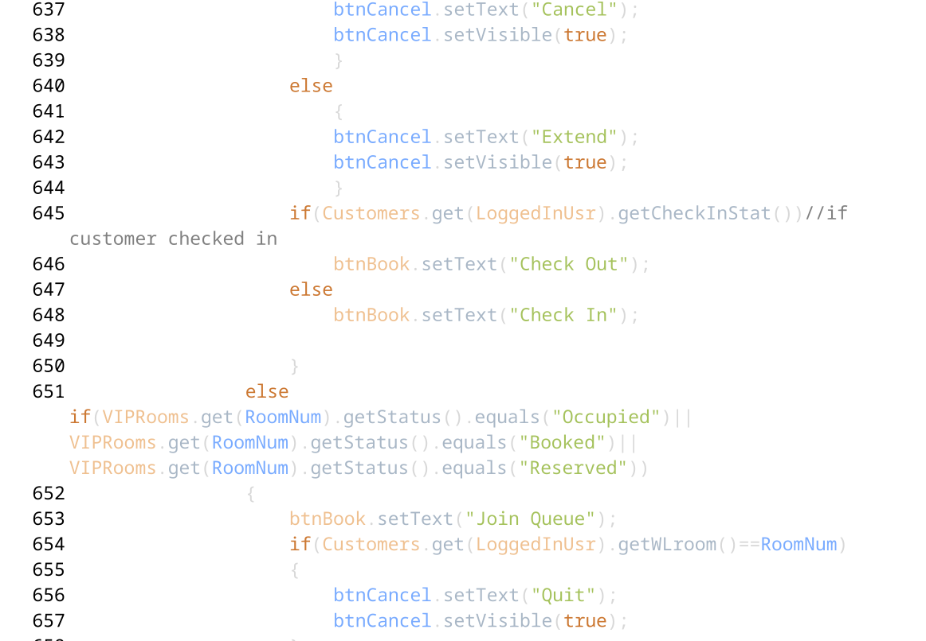
Interaction Example
Login
Iterate through all the Customers HashMap, call get credential to find the correct account
Generate a new Shopping Cart object for purchasing
Set LoggedInUsr to that Key
Change the layout and the button of the GUI
Chek in
Locate the Customer object using LoggedInUsr variable
Call the Check In method to set check in time
Change Room object status to Occupied
Set the Book button to check out

Slide 17
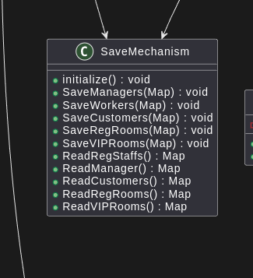
Saves
SaveMechanisms included every method needed to load and save data.
Including auto generate destination and files
Serializable makes it have higher security level
Using HashMap to store every object
Easy to access
Easy to locate each object (With the key)
Easy to modify

Slide 18
Special Thanks!
Eclipse maintainer, Market Place extension contributors
All Stack Overflow users
Mr. Twiet

